Slide 1
Mokuoane Sidney Ramphalile DLBCSPJWD01 92122454
GitHub Link: https://github.com/SidneyRamphalile/Sidify-Store

Slide 2
Table of Contents
Sidify Store – Explanation and Benefits ……………………………………………………….. 3
Target Audience …………………………………………………………………………………..4
Technologies used : Front-End and Back-End ………………………………………………… 5
Architecture Diagram and Changes ……………………………………………………………. 6
Front-End Screenshot and Short Description …………………………………………………. 7
Back-End Screenshot and Short Description ………………………………………………….. 8
Installation Instructions ………………………………………………………………………… 9
Reason for Technologies Used and Test Cases ……………...………………………………. 10
Screencast Demo of Application ……………………………………………………………… 11

Slide 3
Sidify-Store
An Ecommerce Web Application store where people can seamlessly buy high quality clothes online and then securely make payments using the Stripe payment gateway.
Benefits
You can do shopping at the comfort of your own house, and at the convenience of your own time
You can avoid long traffic jams on the road and long queues at a physical store.
You don’t have to go through the trouble of creating an account and having to login before making a purchase, you simply add your desired item into the shopping cart, go to checkout, make your payment and wait as your product gets delivered to your doorstep.
Men, Women and Teenagers are all represented in their various categories. There are t-shirts, sweaters and footwear for all, with long and lasting quality.

Slide 4
Target Audience
The target audience of this web application is:
Men
Women
Teenagers
People who have a heart for clothes shopping and fashion
People who are into sportswear.

Slide 5








Technologies used: Front-End
HTML Tailwind CSS TypeScript Shadcn/UI Next.Js
Technologies used: Back-End
Node.Js Sanity Stripe

Slide 6
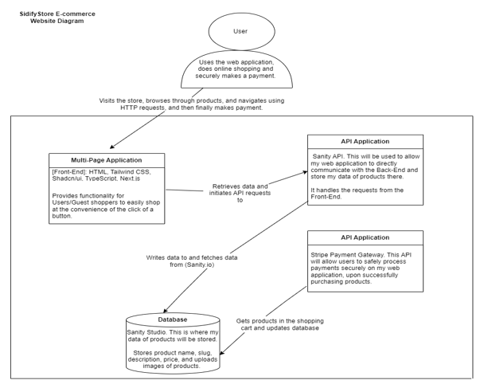
Architecture Diagram & Changes
This is the latest diagram, different from the original one from the first phase. Here are the changes I made: 1. I separated the Stripe API from the Sanity API because they are two different APIs and not one. 2. I shortened the descriptions of my diagrams.

Slide 7
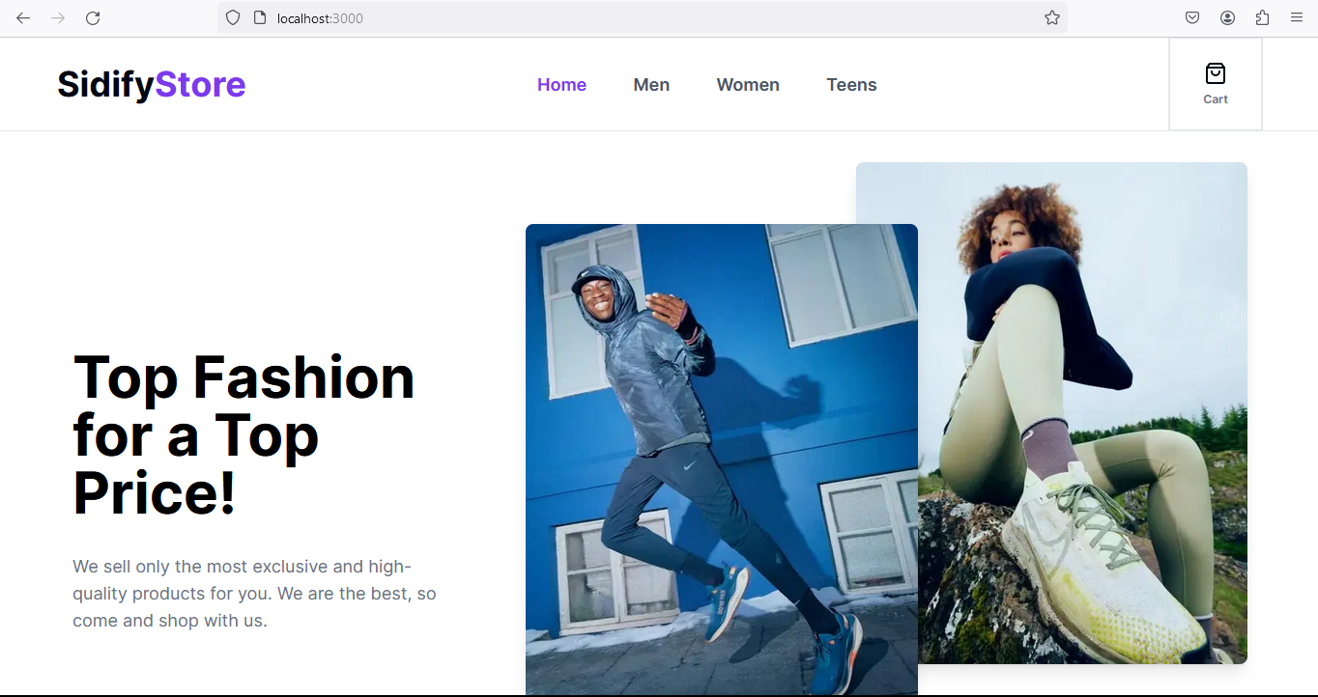
Front-End Screenshot
This is the Home Page of the Sidify Store Web Application.
There are 4 links on the Navigation bar, which are the Home, Men, Women and Teens links, followed by a Cart link shoppers can view the items in their shopping cart

Slide 8
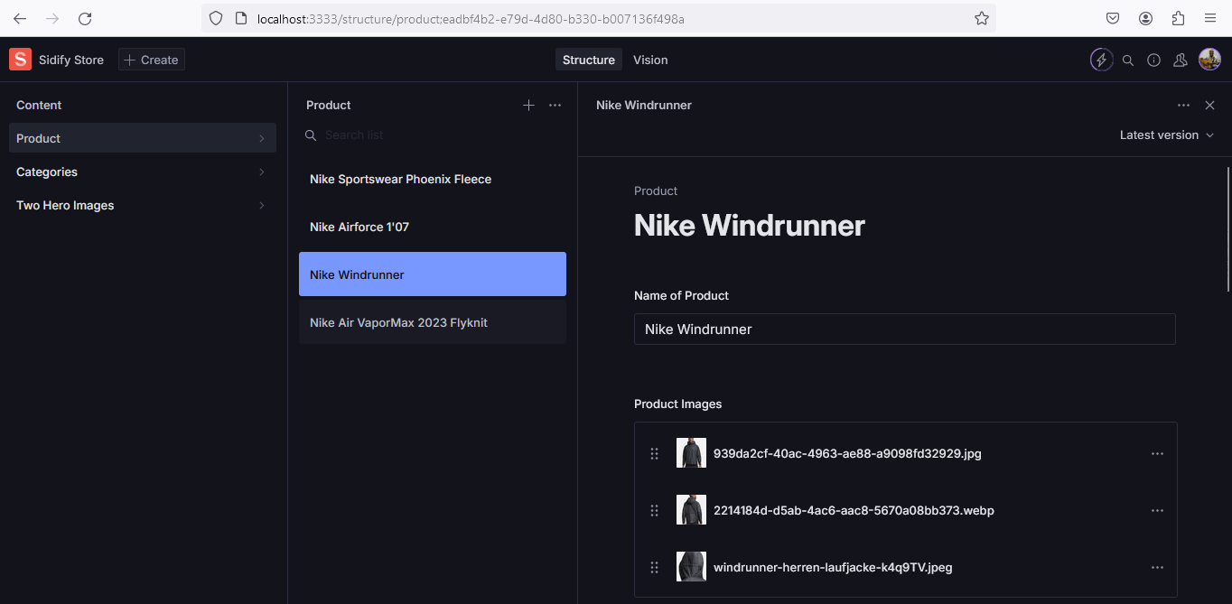
Back-End Screenshot
This is the backend, where I create the Name of the product, the description, slug, price, category and then finally upload the images of the product.
Here I also link the Stripe ID to a specific product so that when a customer adds a specific product to the cart and checks out, then Stripe can bill the correct product.

Slide 9
Installation Instructions
To run this project locally on your machine is very simple. Before running this application, please note that you must have Node.js installed on your machine. If you don't have it on your machine, you can visit this link: https://nodejs.org/en and easily install it.
I would highly recommend that you use Visual Studio Code for ease of access. This can still be done using your terminal, but then you will have to change to the directory of this project. With Visual Studio Code, you just open a new terminal and then you are automatically directed to the location of this project.
Then you simply run "npm install". This will install all the dependencies I installed and used when building this web application, to your machine. These dependencies and packages are in the package.json file.
After that, just simply type "npm run dev" and then it will tell you that the project is running at this address: http://localhost:3000. You can either press the Ctrl button and click that link simultaneously and then it will open the project for you in your web browser OR you can just copy the link and then paste it on your web browser. The application will open and work as expected.

Slide 10
Reason for Technologies used:
Front-End: The reason I used HTML and Tailwind CSS is because Tailwind CSS is a mobile-friendly CSS framework, having a ‘mobile-first’ approach, which will make my application 100% mobile responsive. The reason I chose Shadcn/ui is because it has different components such as buttons and so forth, pre-programmed and I just have to use it, making development faster. The reason I used Next.Js and TypeScript is because it is the fastest and latest technology to build web-applications, with client-side routing and improved security.
Back-End: I used Sanity because it is a content management system which easily handles my backend for me, I just need to focus on creating the product and it will sort out the databases for me. Stripe payment gateway is secure and reliable. I used Node.Js because it allows smooth communication between the backend and the frontend.
Test Cases:
Add Item to Cart – When I click on the ‘Add To Cart’ button, the application should successfully add the selected item to the shopping cart. It PASSED the test.
Remove Item from Cart – When I click on the ‘Remove Item’ button, the application should successfully remove the selected item/s from the shopping cart. It PASSED the test.
Checkout functionality – When I click on the ‘Checkout’ button, I should be greeted with the Stripe payment gateway page, ready to add my credit card details. It PASSED the test.
Successful Payment – After entering my credit card details, when I press on the ‘Pay’ button, a “success” page should load up, letting me know that the payment was successful. It PASSED the test.

Slide 11
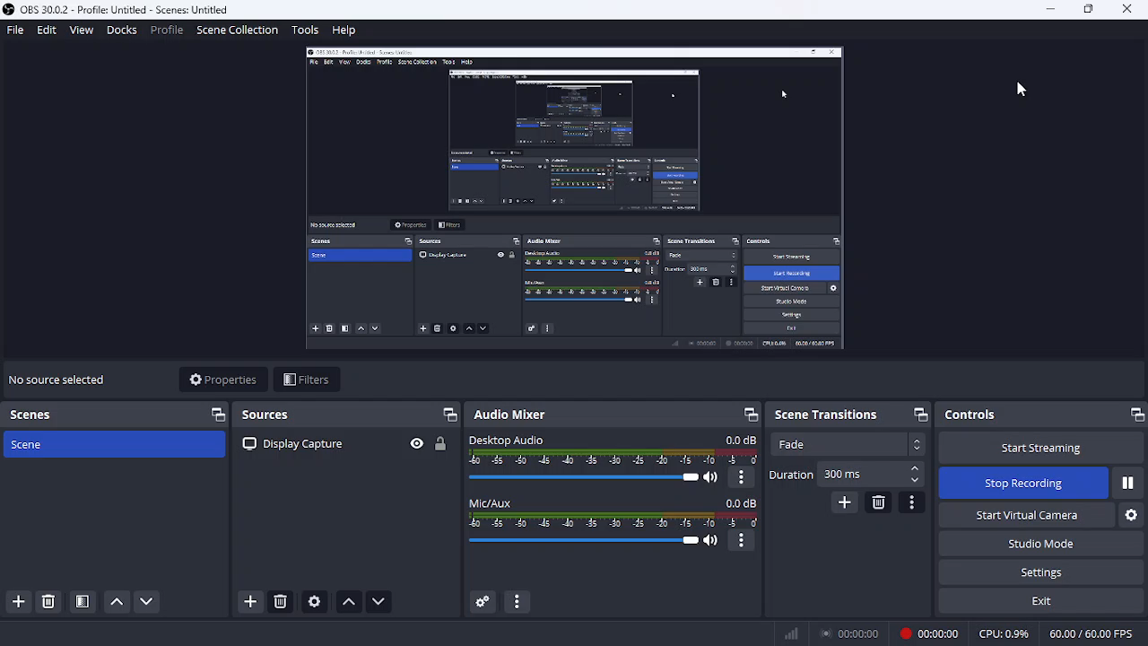
Screen Cast Demo of my Web Application

